Slide 1


Docscribe
Where creativity meets productivity

Slide 2

Mentor: Prof. Hitesh Patel
Group: G42
Group Members:
Keshvi Patel
Tejas Patel
Tirth Patel
Vishakha Rajput

Slide 3

introduction
DocScribe is an all-in-one workspace and collaborative platform that allows individuals and teams to organize their work, information, and projects in a centralized and flexible manner.
It has an ability to replace multiple productivity tools with a single, cohesive platform, providing a unified workspace for a wide range of tasks.
Whether it's co-authoring documents, managing projects, or providing feedback, DocScribe's collaborative tools enhance communication and productivity in real-time.

Slide 4
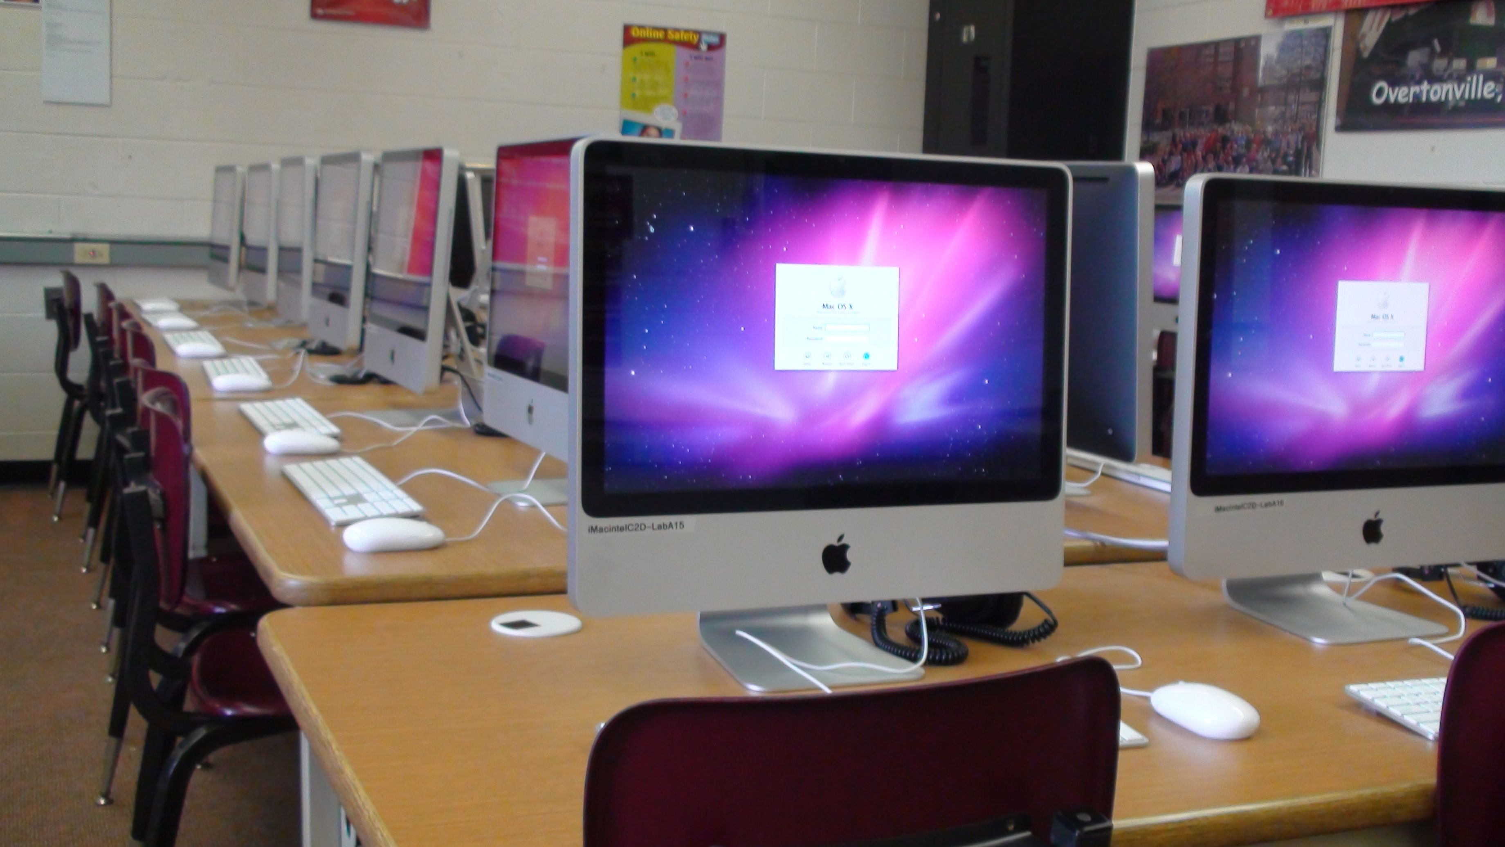
Abstract
DocScribe is used to address the need for a unified and versatile workspace that could seamlessly integrate various productivity and collaboration tools into a single platform.
The concept of DocScribe is to overcome the limitations and fragmentation associated with using multiple applications for tasks such as note-taking, project management, document collaboration, and knowledge organization.

Slide 5

Objectives of study
The major goal of DocScribe is to provide a unified and versatile workspace that addresses the diverse needs of individuals and teams in the realm of productivity, collaboration, and information management.
Following are our objectives:
User-Friendly
Easy to Use
Organizing Information
Task and Project Management
Collaboration and Teamwork
Project Planning and Tracking
Centralized Communication
Cross-Platform Accessibility
Note-Taking and Documentation

Slide 6
System analysis

Slide 7
User Interface(UI): The UI is designed to be user-friendly, with a sidebar for navigation, a central workspace for content creation, and a top bar for additional controls and settings.
Simultaneous Editing: Changes made by one user are immediately reflected for others, allowing for a seamless collaborative editing experience.
Cursor Presence: You can see the cursor position and edits being made by collaborators, enhancing awareness and coordination during collaborative work.
Live Preview: The instant feedback allows collaborators to see how the document evolves in real-time, promoting an iterative and collaborative writing process.

Slide 8
Real-Time Updates Across Devices: Whether on the web, desktop, or mobile app, users can stay in sync with the latest edits made by team members.
Task and Project Management Collaboration: DocScribe's task management features, including boards and databases, enable teams to collaboratively manage projects. Changes to tasks, due dates, and project statuses are updated in real-time.
Cross-Platform Accessibility: DocScribe is accessible across multiple platforms, including web browsers, desktop applications (Windows and macOS), and mobile apps (iOS and Android).
Security and Permissions: Users can define who has view-only access, editing rights, or commenting privileges for a particular workspace or page.

Slide 9
Technologies

Slide 10

Next.Js 13 with file-based routing for easy development.
React for the creation of dynamic and responsive UI components.
Tailwind CSS for fast and responsive styling.
Drizzle ORM used for database interactions.
Shadcn UI's CLI to integrate the library with your applications, add dependencies, and apply the relevant tailwind configurations.
Socket io is a library for real-time web applications, allowing for bidirectional communication between clients and servers.
Supabase allows to store and manage data in a web or mobile application.
Stripe API facilitate payments and pay out sellers globally.

Slide 11
Requirements

Slide 12
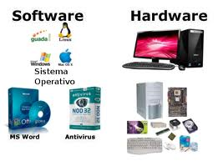
Software requirements
Frontend Tools: Next.JS, Tailwind CSS, TypeScript
Database: Mongo DB
OS: Windows
Browser: Google Chrome, Mozilla Firefox etc.
Hardware requirements
Processor: 2.20GHz
RAM: 8GB
Hard Disk: 1TB free space

Slide 13
Diagrams

Slide 14
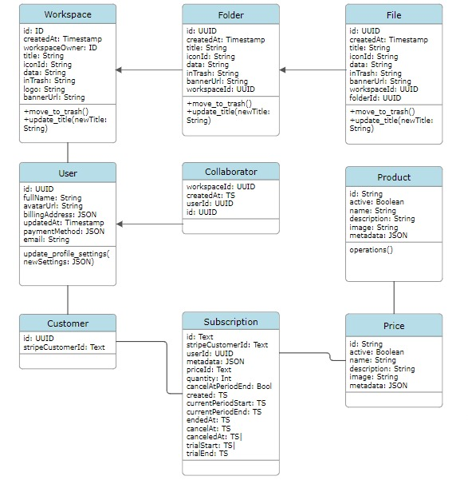
Class diagram

Slide 15
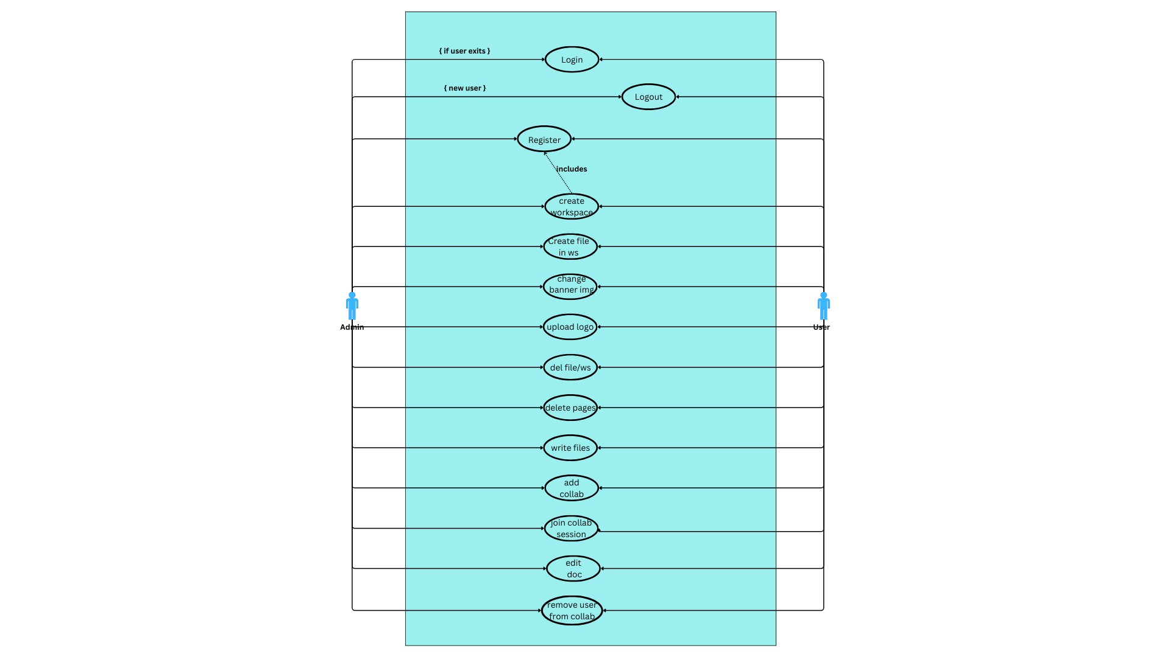
Use case diagram

Slide 16

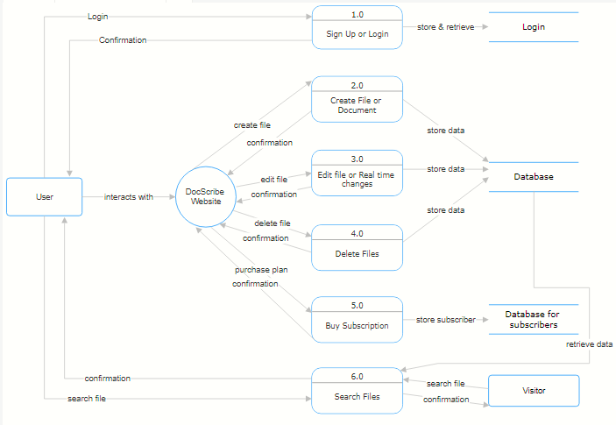
Data flow diagram

Slide 17
screenshots

Slide 18
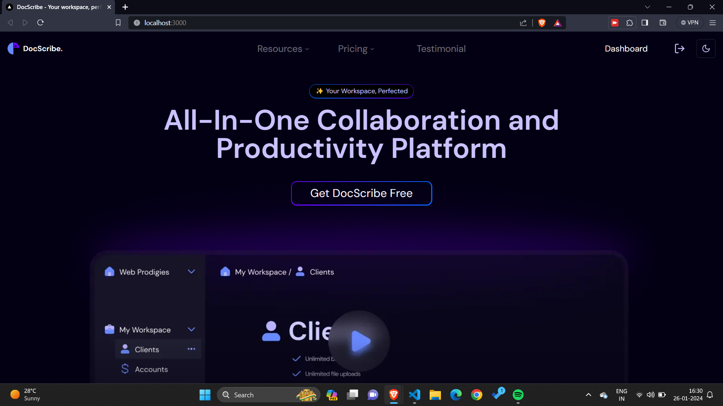

Slide 19
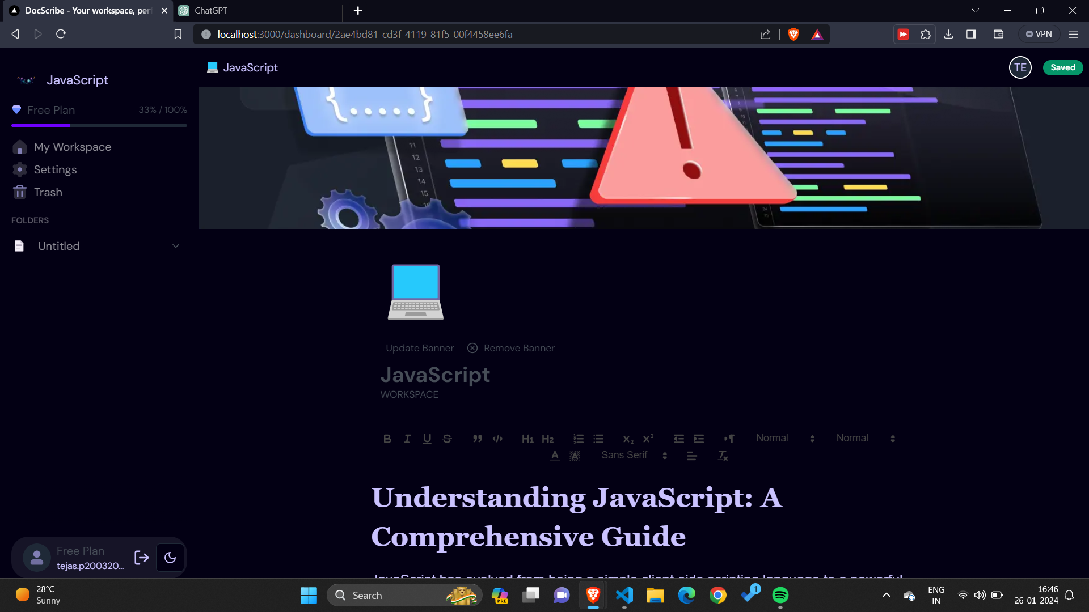

Slide 20
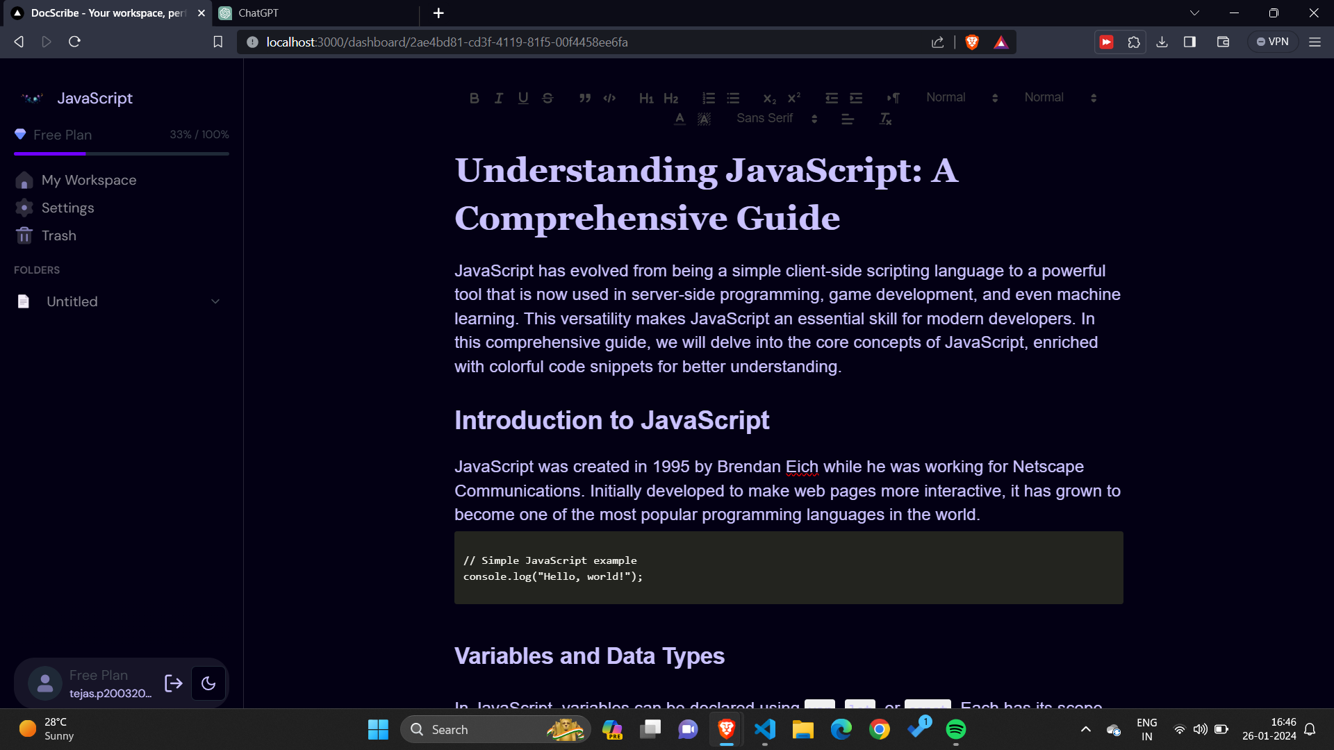

Slide 21
references

Slide 22
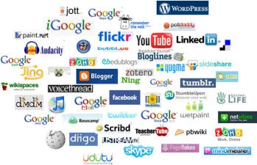
references
https://tailwindcss.com/docs/installation
https://nextjs.org/docs
https://ui.shadcn.com/docs
https://socket.io/
https://orm.drizzle.team/
https://supabase.com/

Slide 23


Thank you

